Slide 1
Geographical Account of Sri Lanka
Presented by
Dev Prakash
Assistant Professor, Dept. of Geography
Daudnagar college, Daudnagar
Aurangabad (Bihar)

Slide 2
Introduction
Sri Lanka, formerly known Ceylon, is a island country lying in the Indian Ocean and separated from peninsular India by the Palk Strait. It is located between latitudes 5°55′ and 9°51′ N and longitudes 79°41′ and 81°53′ E and has a maximum length of 268 miles (432 km) and a maximum width of 139 miles (224 km).
At a crossroads of maritime routes traversing the Indian Ocean, Sri Lanka has also been exposed to cultural influences from other Asian civilizations. Ancient Greek geographers called it Taprobane. Arabs referred to it as Serendib. Later European mapmakers called it Ceylon, a name still used occasionally for trade purposes. It officially became Sri Lanka in 1972. It is also known as pearl of Asia.
In 1948, after nearly 150 years of British rule, Sri Lanka became an independent country, and it was admitted to the United Nations seven years later. The country is a member of the Commonwealth and the South Asian Association for Regional Cooperation.

Slide 3
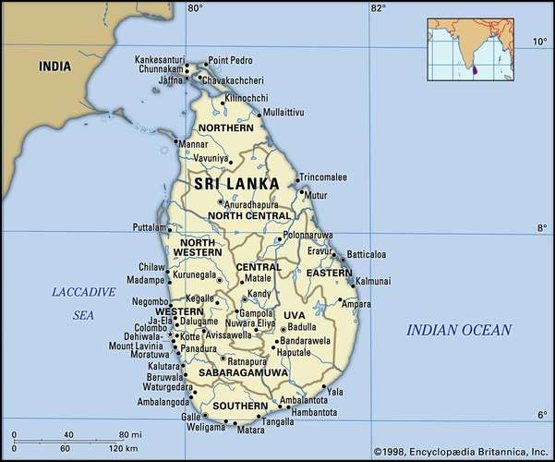
Location of Sri Lanka

Slide 4
Geological Structure
Geologically, the island of Sri Lanka is considered a southerly extension of peninsular India , with which it shares a continental shelf and some of its basic lithologic and geomorphic characteristics. Hard, crystallin rock formations, such as granite, gneisses, khondalite (a type of metamorphic rock), and quartzite, make up about nine-tenths of the island’s surface and subsurface.
More than 90% of Sri Lanka's surface lies on Precambrian strata, some of it dating back 2 billion years. The granulite facies rocks of the Highland Series (gneisses sillimanite-graphite gneisses, quartzite, marbles, and some charnockites) make up most of the island and the amphibolite facies gneisses, granites, and granitic gneisses of the Vinjayan Series occur in the eastern and southeastern lowlands. Jurassic sediments are present today in very small areas near the western coast.
Miocene limestones underlie the northwestern part of the country and extend south in a relatively narrow belt along the west coast. The metamorphic rock surface was created by the transformation of ancient sediments under intense heat and pressure during mountain-building processes. The theory of plate tectonics suggests that these rocks and related rocks forming most of south India were part of a single southern landmass called Gondwanaland.

Slide 5
Relief
A roughly triangular mountainous area known as the Central Highlands occupies the south-central region of Sri Lanka and is the heart of the country. This highland mass is surrounded by a diverse plain, the general elevation of which ranges from sea level to about 1,000 feet (300 metres). This plain accounts for about five-sixths of the country’s total area.
The Central Highlands have a highly dissected terrain consisting of a unique arrangement of plateaus, ridges, escarpments, intermontane basins, and valleys. Sri Lanka’s highest mountains—Pidurutalagala at 8,281 feet (2,524 metres), Kirigalpotta at 7,858 feet, and Adam’s Peak (Sri Pada) at 7,559 feet—are found in this area. The highlands, except on their western and southwestern flanks, are sharply defined by a series of escarpments, the most spectacular being the so-called World’s End, a near-vertical precipice of about 4,000 feet.

Slide 6
Relief
The plain that surrounds the Central Highlands does not have an entirely flat and featureless terrain. To the north and northeast of the highlands, the plain is traversed by low ridges that decrease in altitude as they approach the coast. The western and southwestern parts of the plain feature alternating ridges and valleys running parallel to the coast and increasing in elevation toward the interior to merge imperceptibly with the highland mass. Elsewhere the flatness of the plain is sporadically interrupted by rocky buttes and mounds, some of which reach elevations of more than 1,000 feet. The plain is fringed by a coast consisting mostly of sandy beaches, spits, and lagoons. Over a few stretches of the coast there are rocky promontories and cliffs, deep-water bays, and offshore islets.

Slide 7
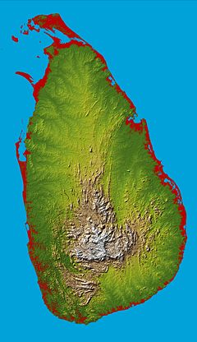
Fig. Relief map of Sri Lanka
The Central Highland

Slide 8
Climate
Sri Lanka’s tropical location ensures perennially high temperatures, with monthly averages between 72 °F (22 °C) and 92 °F (33 °C) in the lowlands. In the Central Highlands, higher altitudes account for lower temperatures, with monthly averages between 44 °F (7 °C) and 71 °F (21.6 °C).
Rainfall is the conspicuous factor in the seasonal and diurnal variations of the climate of Sri Lanka. Most parts of the country receive an average annual rainfall of more than 50 inches (1,270 mm). However, regional differences in the amount of rain, its seasonality, and its variability and effectiveness have formed the basis of a distinction in Sri Lanka between a Wet Zone and a Dry Zone. In the former area, which covers the southwestern quadrant of the island (including the highlands), the rainfall is heavy (annual averages range from 98 inches along the coast to more than 150 inches in the highlands) and seasonally well distributed (although a greater part of the rain comes from the southwest monsoon from May to September). Rainfall deviates relatively little each year from the annual averages and is effective enough to maintain soil moisture and surface drainage throughout the year. Over the rest of the island—the Dry Zone—annual totals of rain range from 30 to 70 inches in the different areas (much of it being received during the northeast monsoon season from November to January). Droughts that persist for more than three months are common.

Slide 9
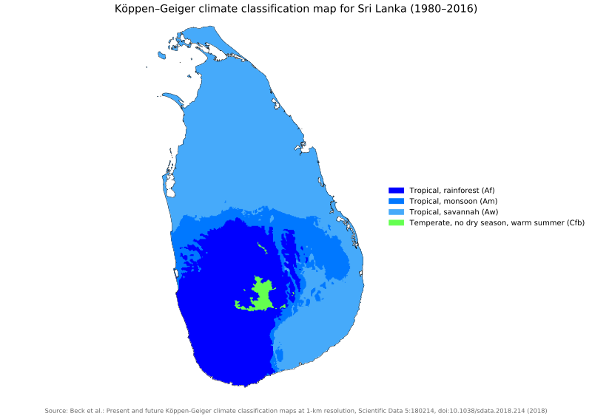

Slide 10
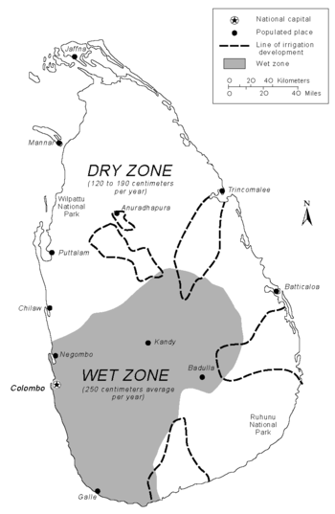
Precipitation Map of Sri Lanka

Slide 11
Drainage
The surface drainage of Sri Lanka is made up of about 100 “rivers,” most of which are mere wet-season rivulets. Twelve major rivers account for about 75 percent of the mean annual river discharge of the country, with those that flow entirely through the Wet Zone (the highlands and the southwestern part of the country carrying about half the total discharge.
With the exception of the 208-mile-long Mahaweli River, all major rivers flow radially from the Central Highlands to the sea. The Mahaweli, which originates on the western slopes of the highest areas of the highlands, follows a circuitous route in its upper reaches before it enters the plain to the east of the highlands and then flows toward the northeast coast. Because a part of its catchment is well within the Wet Zone, this river has a larger and less seasonally varied flow than the other Dry Zone rivers and so is a major asset for irrigation in the drier parts of the country (the Dry Zone includes the northern part of the country and much of the east and southeast).

Slide 12
Soils
Variations of soil within Sri Lanka reflect the effects of climate, lithology, and terrain on the soil-forming processes. The climatic influences are reflected in the dominance of red-yellow podzolic soils (leached lateritic soils) in the Wet Zone and of reddish brown earths (nonlateritic loamy soils) in the Dry Zone. In parts of the Central Highlands there are reddish brown latosolic soils (partially laterized soils) or immature brown loams (clayey loams). Among the other important soil types are the alluvials that occur along the lower courses of rivers and the regosols (sandy soils) of the coastal tracts.
Most of the soils of Sri Lanka are potentially suitable for some kind of agricultural use. However, depletion of the natural fertility of the soil has occurred extensively, especially on the rugged terrain of the highlands, owing to poor soil conservation.

Slide 13
Natural Vegetation & Wild life
Sri Lanka’s natural vegetation covers about one-third of the total land area. The climax vegetation (i.e., natural vegetation permitted to develop uninterrupted) in most parts of the country is forest. In the Wet Zone, tropical wet evergreen forest dominates in the lowlands, and submontane and montane evergreen forests prevail in the highlands. The Dry Zone has a climax vegetation of dry evergreen forest and moist deciduous forest , with forests giving way to a stunted, shrubby, xerophytic (drought-tolerant) vegetation in its driest parts. In the highest areas of the Central Highlands, forests tend to be sparse and interspersed with grasslands.
Most of Sri Lanka’s climax vegetation cover has been heavily depleted by extensive clearing of forests for settlements, extraction of timber, and agriculture. Only the Sinharaja forest and the Peak Wilderness of the southwestern interior remain as significant remnants of the Wet Zone’s original evergreen forests. The forests found in most parts of the Dry Zone are secondary vegetation, which probably developed after hundreds of years of repeated clearing and cultivation.
The virgin forests of Sri Lanka are rich in their variety and profusion of flora and fauna. Wildlife, including elephants, leopards, bears, buffalo, and peafowl, and tree species such as ebony, mahogany, satinwood, and teak are being rapidly depleted by indiscriminate exploitation.

Slide 14
Economic activities
Agriculture
Rice production is the most important economic activity of Sri Lanka’s peasantry. Since independence there has been an impressive increase of paddy production.
Tea the preeminent crop of the plantation sector, grows in many parts of the Wet Zone. Crops that are concentrated at higher altitudes supply some of the best-quality black teas to the world market.
The main rubber-growing area is the ridge-and-valley country of the Wet Zone interior.
Coconut is grown mainly in the hinterland of the western seaboard.
Fisheries
In fisheries, the resource potential is abundant, particularly on the north and northwest coasts. Constraints on development are largely technological. Fishing, however, is an important occupation for the people living along the coastal fringe.
Forestry
Forestry is relatively insignificant components of the economy. Forests had been cleared for settlement and agriculture at an estimated rate of 104,000 acres annually between 1956 and 1981. Extraction of timber and fuelwood from forests is constrained by environmental conservation.

Slide 15
Industries
Mining industry- Sri Lanka’s mineral-extraction industries include mining of gemstones and graphite; excavation of beach sands containing ilmenite and monazite; and quarrying kaolin, apatite, quartz sand, clay, and salt. Among them, gem mining is the most important, producing high-value gemstones such as sapphire, ruby, and topaz, in addition to a variety of semiprecious stones, most of which reach foreign markets. Graphite, limonite, and monazite, exported in semi processed form, contribute on a small scale to Sri Lanka’s foreign earnings. The other minerals are used locally as raw materials in the manufacturing and construction industries.
Rubber industry- It is the world’s 6th largest exporter and the 8th largest natural rubber producing country.
Coconut industry
Tobacco industry
Shipping industry
Petroleum industry

Slide 16
Population
At independence Sri Lanka had a population of about 6.5 million, which by the early 1990s had increased to more than 17 million. The rate of population growth averaged about 2.6 percent annually up to the early 1970s and declined steadily to below 1 percent at the turn of the 21st century. By the end of the civil war, the population had reached more than 21 million, but its growth rate remained below 1 percent well after the war.
The population is young. About one-fourth of the population is under the age of 15, and nearly half of the population is under the age of 30. Life expectancy is 81 years for women and 74 years for men.
Three ethnic groups—Sinhalese, Tamil, and Muslim—make up more than 99 percent of the country’s population, with the Sinhalese, alone accounting for nearly three-fourths of the people.
Among the principal ethnic groups, language and religion determine identity. While the mother tongue of the Sinhalese is Sinhala—an Indo-Aryan language—the Tamils speak the Dravidian language of Tamil. Again, while more than 90 percent of the Sinhalese are Buddhists, both Sri Lankan and Indian Tamils are overwhelmingly Hindu. The Muslims—adherents of Islam—usually speak Tamil. Christianity draws its followers (about 7 percent of the population) from among the Sinhalese, Tamil, and Burgher communities.

Slide 17
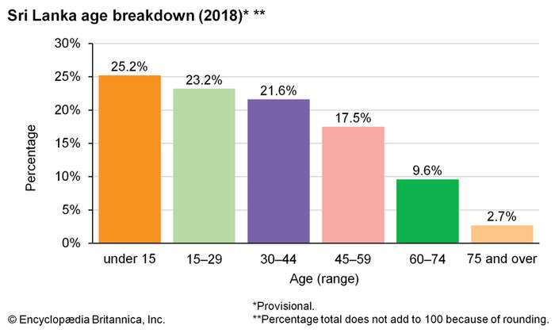

Slide 18
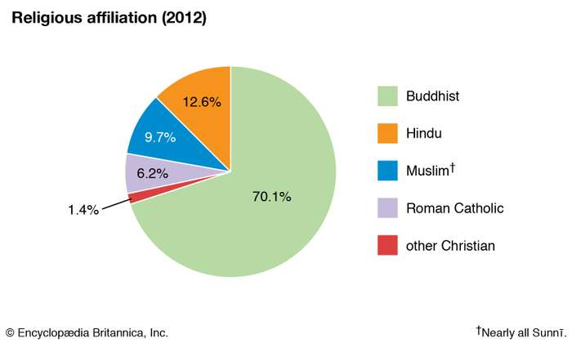
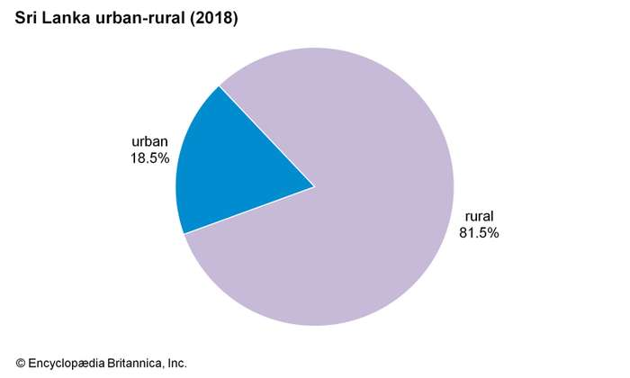
Demographic characteristics of Sri Lanka

Slide 19
Transportation
Road and rail transport accounts for an overwhelmingly large share of the movement of people and commodities within Sri Lanka. In rail transport the government holds a monopoly. Passenger transport by road is shared by the government and the private sector. The private automobile remains a luxury that only the affluent can afford. The bicycle and the bullock cart are important modes of conveyance, especially in rural areas.
Sri Lankan Airlines (formerly Air Lanka), the national airline, operates regularly between its base at Colombo and dozens of major cities in Asia, Europe, and North America. The seaport of Colombo handles the bulk of Sri Lanka’s shipping, including some transshipments of the Indian ports. International cargo is also handled by the ports at Trincomalee and Galle.

Slide 20
Trade
Changes in agriculture and industry brought about a decline in the relative importance of plantation products among the exports and of food commodities among the imports. This, however, has not reduced the adverse balance in foreign trade from which the economy continues to suffer. Much of the trade deficit results from transactions with the industrialized countries of Asia, including India, China, and Japan, from which imported manufactured goods originate. Singapore and the United Arab Emirates are also major sources of imports. The United States, the United Kingdom, Italy, and Germany are all important export destinations.

Slide 21
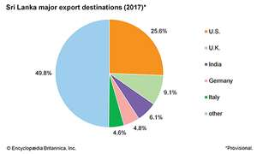
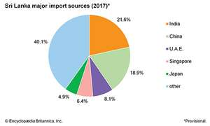
Trade of Sri Lanka

